Slide 1
Virtual Labs 3.0
Senior Project – Summer 2015
Crystal Rivera – Scrum Master
Johann Henao
Daniel Gonzalez
Juan Riano
Trung Ngo

Slide 2
PROBLEM Definition
The current system provides an interface in eFront ,which integrates with Moodle, that allows students to reserve different types of resources which include virtual labs, mentoring and certificate exams. The system also utilizes a combination of Vmware, KVM, and Java applets to host the RDP sessions for the labs.
Current Limitations
Utilizing Moodle is unnecessary since the eFront LMS can handle the modular functionality we need.
Java applets are becoming outdated and are being phased out of most major browsers.
Rather than using both KVM and Vmware, it was decided for uniformity to convert to just KVM

Slide 3
Project Management

Slide 4
Requirements
implemented use cases

Slide 5
Guacamole for vlabs implemented stories
Device a performance test for Guacamole.
Accept REST calls with parameters to relay RDP sessions.
Create a Guacamole installer.
Create documentation for the Guacamole performance test script.
Find out what Guacamole parameters can be passed via URL.
Encrypt/Decrypt password in URL passed to Guacamole.
Restrict machines to which Guacamole allows connections.
Deploy Guacamole to vLabs servers.
Finish testing, commenting and documenting the Guacamole plugin.

Slide 6
System design
Design & deployment

Slide 7
Completed Use Cases
Name | Open a Guacamole RDP session.
Description: | Open a Guacamole RDP session by providing it with the remote host and user information via the URL.
Actors: | Tomcat application server.
Pre conditions: | Ubuntu server with Tomcat and Guacamole.
Post conditions: | Tomcat delivers an RDP session to the web browser.
Success Scenario: | Tomcat receives a request for a Guacamole URL which includes a remote server and user information. Tomcat requests Guacamole to handle the request. Guacamole validates the host information and authenticate the user. Guacamole creates the RDP session and returns it to Tomcat to be displayed in the browser.
Extensions: | The remote computer is not available. The remote computer information is incorrect. The remote computer is not in the permitted range. The user credentials are incorrect.

Slide 8
Completed Use Cases
Name | Restrict host to which Guacamole can connect.
Description: | To prevent abuse, Guacamole should limit access only to a set of specific remote host ranges.
Actors: | Guacamole administrator.
Pre conditions: | Guacamole with guacamole-auth-url plugin installed.
Post conditions: | RDP connections are authorized only if the host is in the list of approved ranges.
Success Scenario: | Guacamole received an RDP connection request. Guacamole invokes the guacamole-auth-url plugin to handle the authentication. The plugin validates the remote host information against the ranges stored in the restructions.txt file. After host validation the user is authenticated and the RDP session is established.
Extensions: | The remote host is not within any permitted range.

Slide 9
Completed Use Cases
Name | Install Guacamole and guacamole-auth-url
Description: | Virtual Labs specific requirements that guacamole-auth-url provides. Install Guacamole along with the plugin.
Actors: | Guacamole administrator.
Pre conditions: | Ubuntu server 14.04 with internet access.
Post conditions: | Guacamole, guacamole-auth-url and all the software requirements are installed.
Success Scenario: | The administrator set the 2 configuration files (key.key and restrictions.txt) The administrator execute as root the guacamole-vlabs-installer.sh script. The administrator execute as root the guacamole-properties.sh script.
Extensions: | Required libraries fail to download. Internet connection is unavailable.

Slide 10
Completed Use Cases
Name | Stress test Guacamole & Monitor Guacamole’s impact on the Host Server.
Description: | Guacamole for Virtual Labs must be able to handle 100+ concurrent RDP sessions. Guacamole must handle that without bringing the host server to a halt.
Actors: | Guacamole administrator.
Pre conditions: | Ubuntu server 14.04 with Guacamole and the guacamole-noauth plugin setup.
Post conditions: | Logs files with test results. Charts bases on logs.
Success Scenario: | The administrator sets 100+ virtual windows machines. and 40+ bare metal windows computers. The administrator executes the guacamole-performance-test.py script. The administrator opens 3 RDP connections through Guacamole with each computer. The script displays and logs the server’s resources behavior as connections are added.

Slide 11
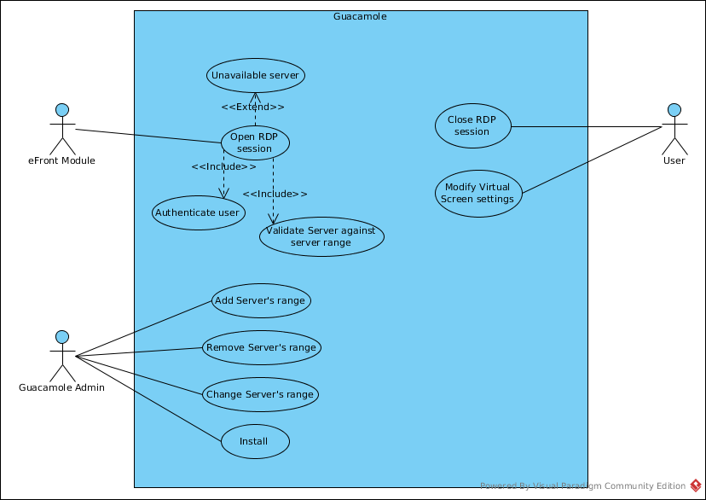
Use case diagram

Slide 12
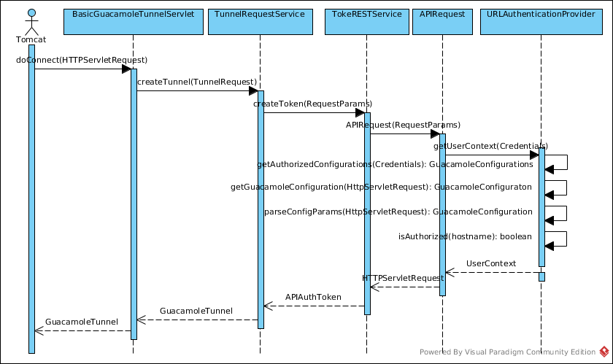
Sequence diagram

Slide 13
System decomposition
Virtual Labs is implemented with a three tier architecture pattern.
Guacamole is located in the Presentation Tier, and interacts horizontally with other subsystems that are located in the same tier.
Guacamole’s job is to serve as a bridge between an eFront module that displays a virtual lab, and the actual KVMs.

Slide 14
System deployment
Hardware Requirements | Software Requirements
Dual core 2.2 GHz processor 20 GB hard drive 4 GB of memory 10/100 Mb/s network connection | Ubuntu server 14.04 and over Maven 2 Java JDK 7 and over Apache Tomcat 7 and over

Slide 15
Persistent data design
Guacamole does not implement a persistent data design.
After receiving an RDP connection request, Guacamole processes it and keeps the connection information in RAM.

Slide 16
Security / privacy
To keep users information safe, the guacamole-auth-url plugin can accept encrypted passwords.
Once the user has been authenticated, an authorized user context is created, and the password is disposed. The user context can continue using the system without needing the password until the session is closed either by the user or after it times out after 1 hour of inactivity.

Slide 17
Detailed design
Class & object

Slide 18
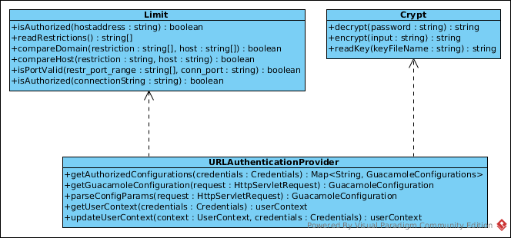
Minimal class design
guacamole-auth-url plugin
Identify design patterns used?

Slide 19
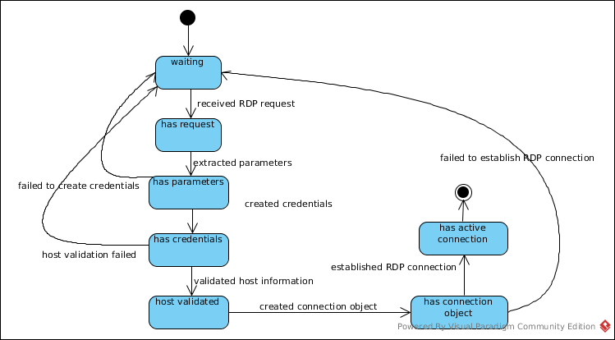
State machine
Guacamole

Slide 20
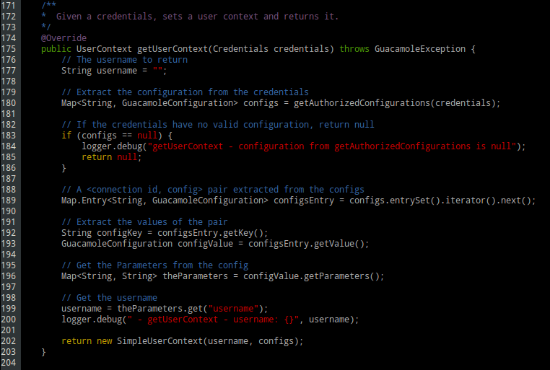
Main Algorithms
guacamole-auth-url plugin

Slide 21
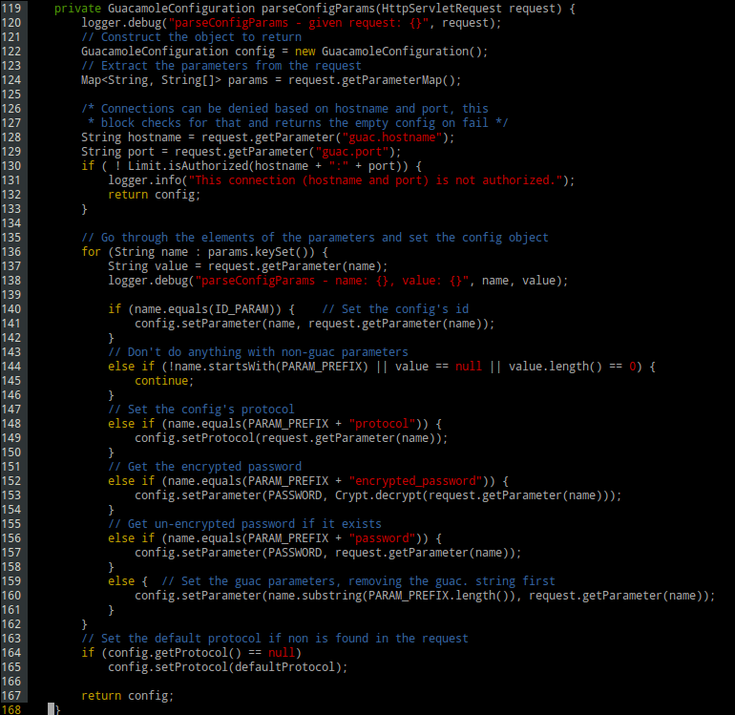
Main Algorithms
guacamole-auth-url plugin

Slide 22
verification
testing

Slide 23
Testing
Performance Testing was used in the application selection phase of the project to make sure that Guacamole would meet Virtual Labs’ system requirements.
During the development phase of the guacamole-auth-url plugin, a Black Box approach was used to test proper coupling with Guacamole.
Unit testing was also used to maintain the code quality.

Slide 24
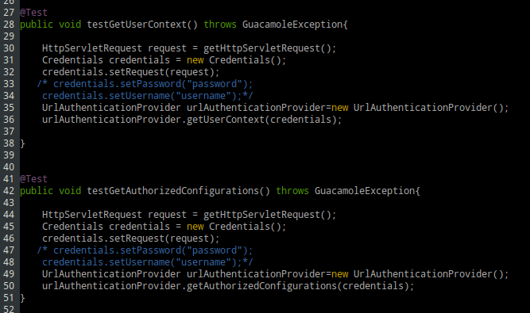
Testing

Slide 25
end

